Slide 1
COMMUNICATION
Chapter 2

Slide 2
Contents
Layered Protocols
Inter Process Communication (IPC)
Message Passing Interface (MPI)
Remote Procedure Call (RPC)
Remote Object Invocation
Remote Method Invocation (RMI)
Message Oriented Communication
Stream Oriented Communication
Group Communication

Slide 3
Due to the absence of shared memory, all communication in distributed systems is based on message passing.
When process A wants to communicate with process B, it first builds a message in its own address space. Then it executes a system call that causes the operating system to fetch the message and send it over the network to node B.
Although this basic idea sounds simple enough, in order to prevent chaos, A and B have to agree on the meaning of the bits being sent.
This is achieved with the help of Protocols

Slide 4
Layered Protocols
A PROTOCOL is a set of rules and conventions that describe how information is to be exchanged between two entities.
Networking tasks often require more than one protocol to perform a task, such as file transfer.
Protocols are structured into layers – where each layer deals with a specific aspect of communication.
Each layer has a well-defined interface to the layers immediately above and below it.

Slide 5
OSI Model (Open Systems Interconnection)
Designed to allow open systems to communicate
Two general type of protocols:
Connection-oriented:
before exchanging data, the sender and the receiver must establish a connection (e.g., telephone), possibly negotiate the protocols to be used, release the connection when done
Connectionless: no setup in advance (e.g., sending an email)

Slide 6
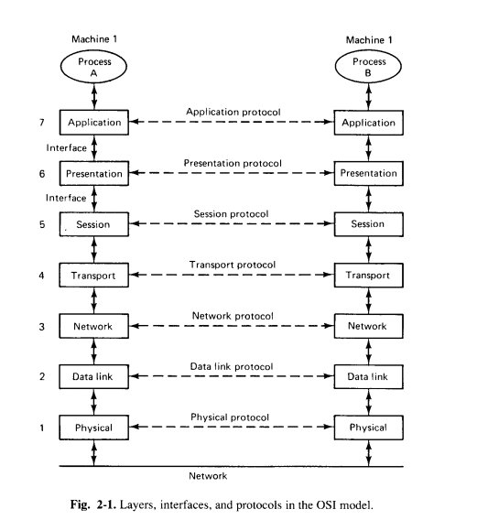

Slide 7
Layer n on machine 1 talks with layer n on machine 2 based on the Layer n protocol
Each protocol adds a header to the original message.
Message sent (downwards) whereas Message received (upwards)
The information in the layer n header is used for the layer n protocol

Slide 8
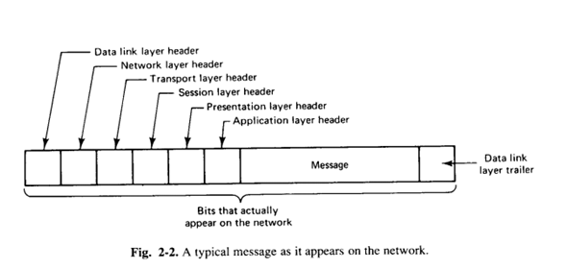

Slide 9
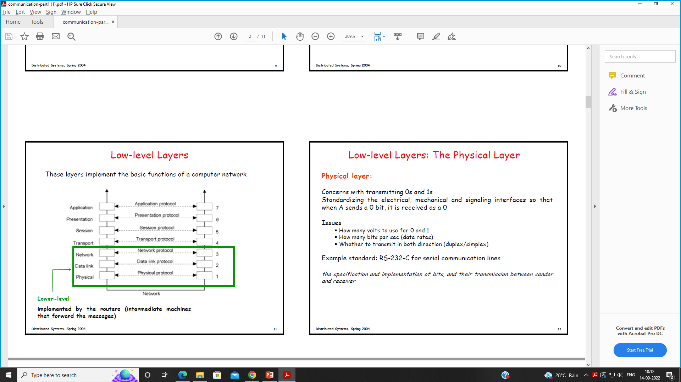
Low-level Layers
These layers implement the basic functions of a computer network.
Lower-level protocols are implemented by the routers (i.e intermediate machines that forward the messages)

Slide 10
Physical layer
Concerns with transmitting 0’s and 1’s
Standardizing the electrical, mechanical and signaling interfaces so that when A sends a 0 bit, it is received as a 0
Issues
How many volts to use for 0 and 1
How many bits to send per sec (data rates)
Whether to transmit in both directions (duplex/simplex)

Slide 11
2. Data link layer
Group bits into frames so as to detect the start and end of a frame and also sees that each frame is correctly received.
Puts a special bit pattern at the start and end of each frame (to mark them) as well as a checksum
If checksums differ, requests a retransmission
Frames are assigned sequence numbers

Slide 12
3. Network Layer
Describes how packets in a network of computers are to be routed.
Deals with the fact that communication might require multi-hops
At each hop, Network Layer decides through which of the available links to forward the packet
Routing: choose the best path (“delay-wise”)
Packets are routed through different paths towards its destination, independent of all others.

Slide 13
4. Transport Layer
It provides the actual communication facilities for most distributed systems.
Breaks the message received from the upper layers into packets and assigns a sequence number to each one of them and send them all.
Also provides Congestion control, fragmentation of packets etc.
Header: which packets have been sent, received, there is room for, need to be retransmitted.
Reliability of transport services can be offered or implemented on top of connection-oriented (all packets arrive in the correct sequence, if they arrive at all) or connectionless network services.
Eg: TCP (Connection oriented) & UDP (Connectionless)

Slide 14
5. Session Layer
It provides dialog control to keep track of which party is currently talking and also Check pointing to ensure recovery in the event of a crash.
6. Presentation Layer
Deals with the syntax and meaning of the transmitted bits.
Helps the machine with different data representations to communicate with each other.
7. Application Layer
The application layer is really just a collection of miscellaneous protocols for common activities such as electronic mail, file transfer, and connecting remote terminals to computers over a network

Slide 15
Inter Process Communication (IPC)
Types of communication:
Synchronous communication :
Client application has to wait after sending a request until the response is received from the server application.
Eg. RPC and RMI.
Asynchronous communication :
Client application can continue working after sending a request without having to wait for the response from the server application.
Eg: Funds transfer from an account, database updating.

Slide 16
Transient communication:
Sender and the receiver both have to be in running state for the delivery of messages sent between them.
Eg: RPC, RMI
Persistent communication:
The sender and the receiver both need not be in running state for the delivery of messages sent between them.
Eg: E-mail

Slide 17
Message Passing Interface (MPI)
Traditional Sockets are inefficient to handle communication between high performance multicomputer.
Thus, MPI was developed for supporting parallel applications and adapted to Transient communication where both sender and receiver should be active during the communication.
The message passing interface (MPI) is a standardized means of exchanging messages between multiple computers running a parallel program across distributed memory.

Slide 18
Benefits of the MPI
The MPI provides the following benefits:
Standardization:
MPI has replaced other message passing libraries, becoming a generally accepted industry standard.
Developed by a broad committee:
Although MPI may not be an official standard, it's still a general standard created by a committee of vendors, implementers and users.
Portability:
MPI has been implemented for many distributed memory architectures, meaning users don't need to modify source code when porting applications over to different platforms that are supported by the MPI standard.
Speed:
Implementation is typically optimized for the hardware the MPI runs on.
Functionality:
MPI is designed for high performance on massively parallel machines and clusters. The basic MPI-1 implementation has more than 100 defined routines.

Slide 19
Remote Procedure Call (RPC)

Slide 20
RPC is a powerful technique for constructing distributed, client-server based applications.
It is based on extending the conventional local procedure calling so that the called procedure need not exist in the same address space as the calling procedure.
RPC mechanisms are used when a computer program causes a procedure or subroutine to execute in a different address space, which is coded as a normal procedure call without the programmer specifically coding the details for the remote interaction.
The two processes may be on the same system, or they may be on different systems with a network connecting them.
A program executing on machine A calls a Procedure or Function located at machine B.

Slide 21
Basic RPC Operation
First the caller process sends a call message with procedure parameters to the server process.
The caller process suspends itself to wait for the reply.
A process on the server side extracts the procedure parameters, computes the results and sends a reply back to the caller procedure.

Slide 22
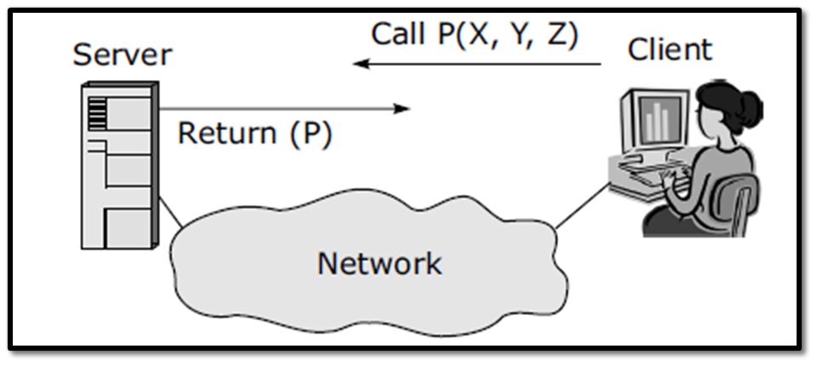
Basic RPC Model

Slide 23
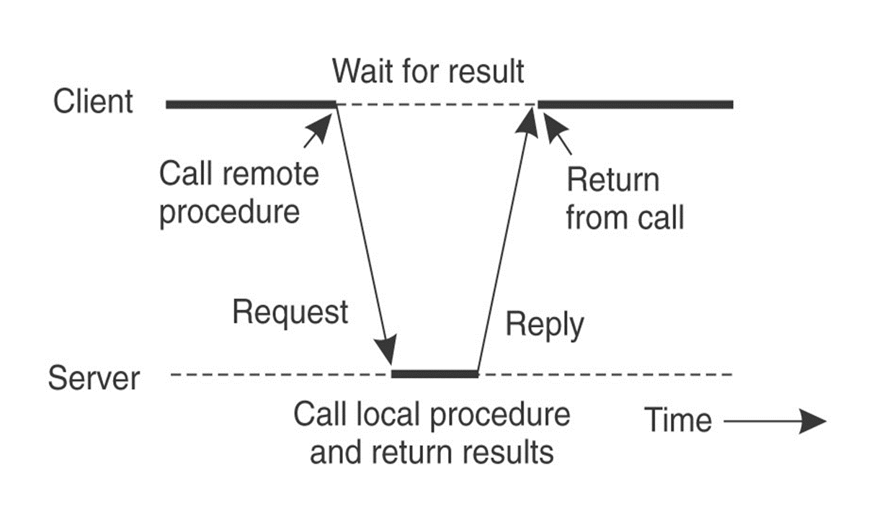
How RPC Works?: RPC Operation

Slide 24
RPC Architecture
RPC architecture has mainly five components of the program:
Client
Client Stub
RPC Runtime (Network Routines)
Server Stub
Server
An instance of client, client stub, and RPC runtime executes on the client machine, while a similar separate instance executes on the server machine.
The caller process is the client and the called process is the server.

Slide 25
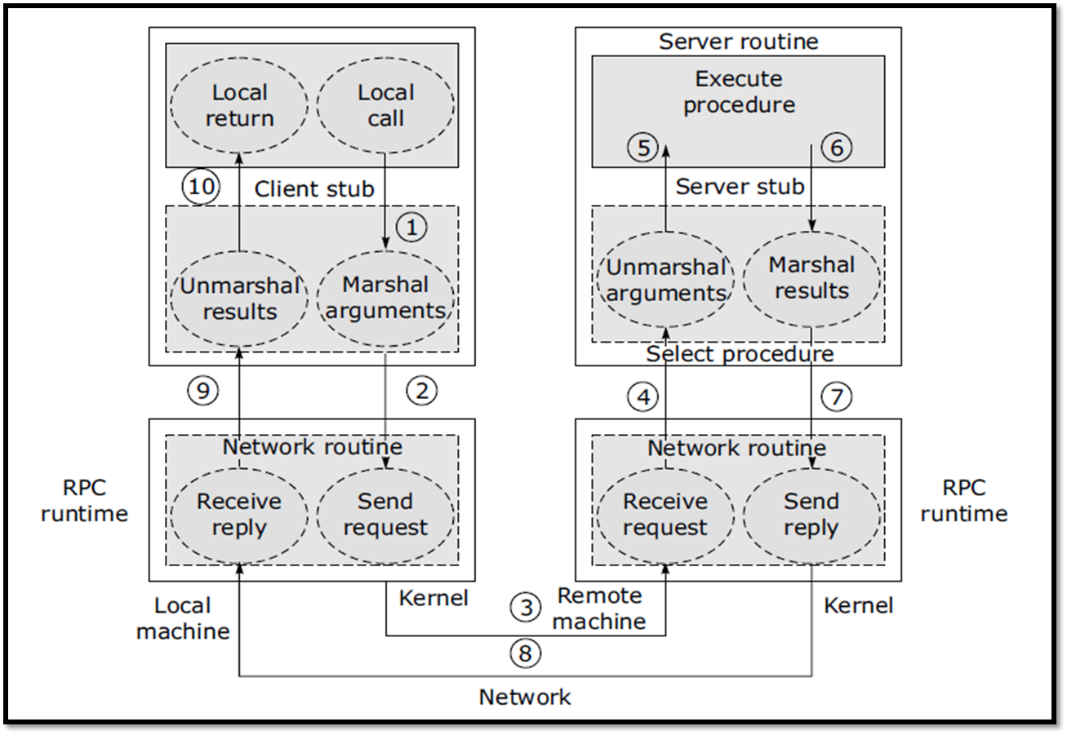

Slide 26
How RPC Works?
Following steps take place during the RPC process:
→The CLIENT calls a local procedure, the CLIENT STUB. For the client it appears as if the client stub is the actual server procedure, which it has called.
→ STUB packages the arguments for the remote procedure in a standard format.
→ Packaging the Client’s arguments into a network message is called as MARSHALLING
CLIENT STUB sends the network messages to the remote system via system call to the local kernel.
Message is transferred to the remote system via connection oriented or a connection less protocol.

Slide 27
The SERVER STUB procedure waits on the remote system for the clients request and UNMARSHALLS the arguments from it.
The server stub executes a local procedure call to invoke the actual server function by passing it the arguments that it received from the client stub.
When the server procedure is completed, it sends the return values back to the server stub.
The server stub converts the return values, marshals them into one or more network messages, and sends them back to the client stub.
The messages are transmitted across the network back to the client stub.
The client stub reads the network messages from the local kernel.
After converting the return values, the client stub returns to the client function.

Slide 28
RPC Implementation
We now discuss the format of RPC messages and how RPCs can be implemented.
RPC Messages
Parameter Passing Semantics
RPC Communication
Server Management
RPC Issues

Slide 29
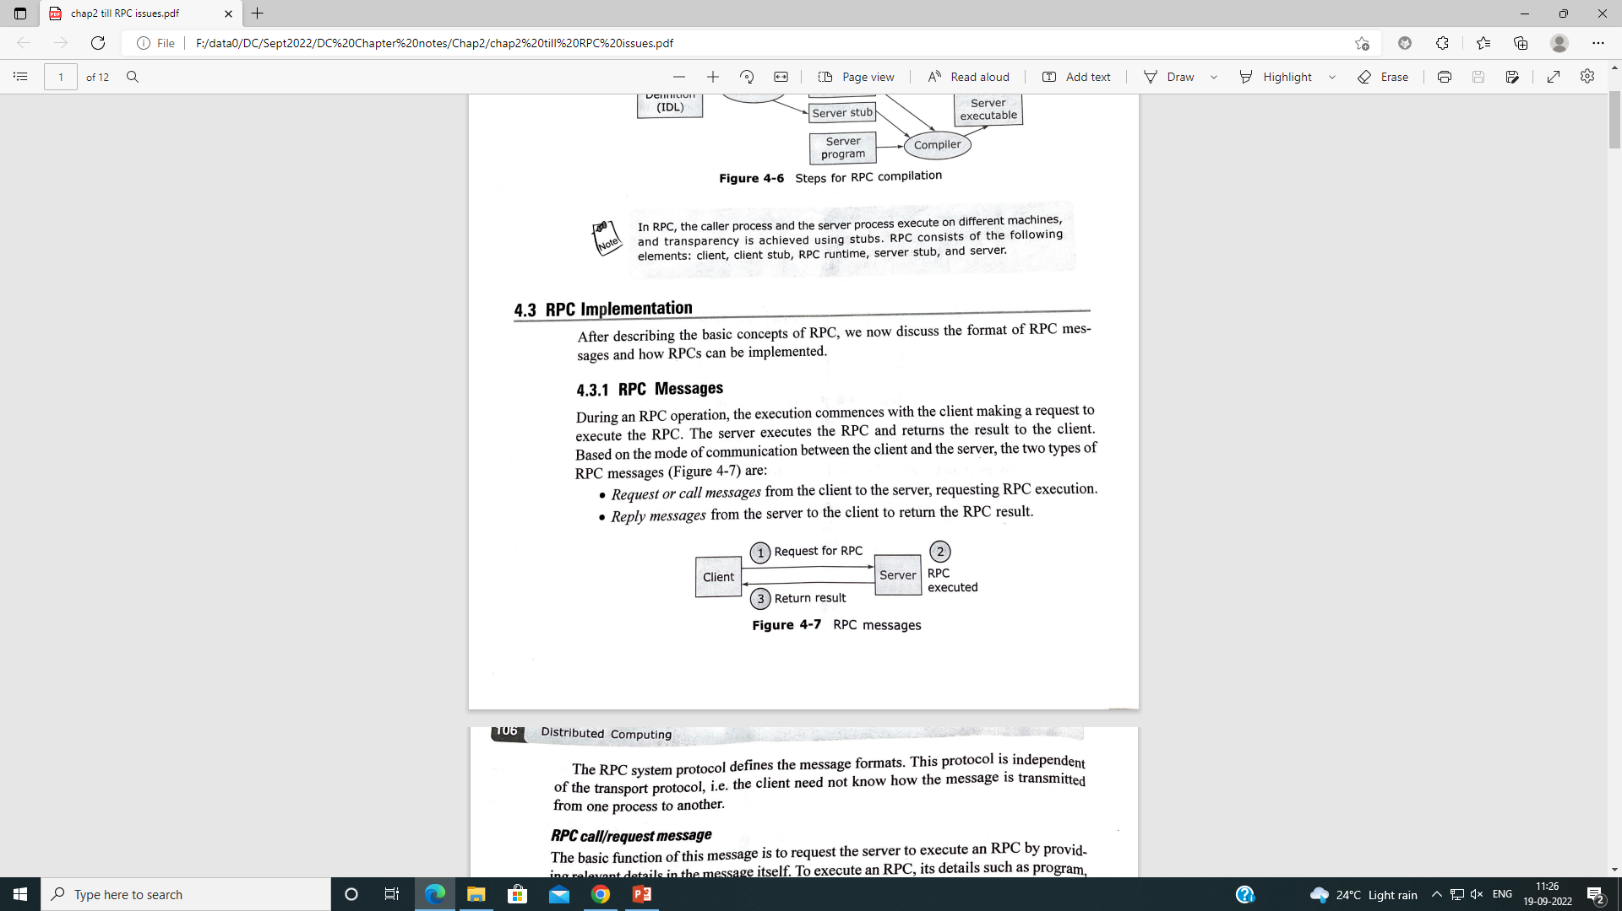
1. RPC Messages
During an RPC operation, the execution commences with the client making a request to execute the RPC.
The server executes the RPC and returns the result to the client.
Based on the mode of communication between the client and the server, the two types of RPC messages are :
Request or call messages from the client to the server, requesting RPC execution.
Reply messages from the server to the client to return the RPC result.
The RPC System Protocol defines the message format.
This protocol is independent of the TRANSPORT protocol, i.e the client need not know how the message is transmitted from one process to another.

Slide 30
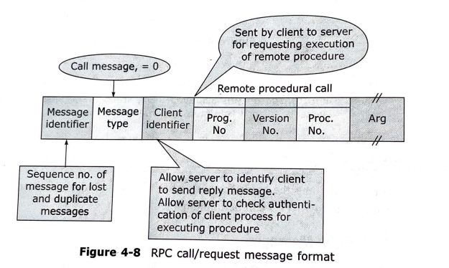
RPC call/request message

Slide 31
RPC call/request message
The basic function of this message is to request the server to execute an RPC by providing relevant details in the message itself.
To execute an RPC, details such as program, version, procedure number and arguments are needed.
Call message has a MsgID field that specifies the sequence number useful for identifying lost or duplicate messages in case of failures and for matching the reply messages to the pending requests if incase they arrive out of order.
Message Type filed (0 or 1) indicates if it’s a call (0) or response (1) type of msg
Client ID field allows the server to identify the client before sending the reply. It also allows the server to authenticate the client before RPC execution.

Slide 32
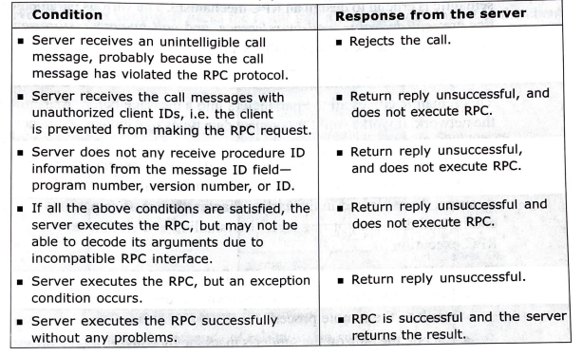
RPC Reply
RPC reply message conditions

Slide 33
In conditions 1 to 5, the client receives an unsuccessful reply, specifying the reason for failure.
The message ID fields of both the request and reply messages are identical to enable a proper match.
The reply message is partially different for unsuccessful and successful replies.
In case of a successful reply, the status field bit in the reply message is set to zero followed by the result field, while for an unsuccessful reply, it is set to one or a non- zero value, which specifies the type of error.

Slide 34
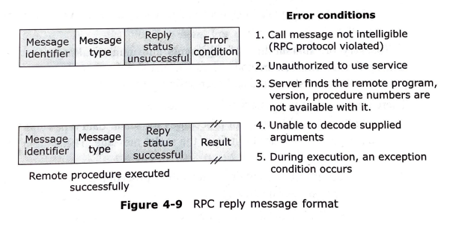
RPC Reply message

Slide 35
2. Parameter Passing Semantics
The function of the client sub is to take parameters from the process, pack them into a message, and send it to the server stub.
The choice of a suitable parameter passing semantic is crucial to design an RPC mechanism.
The various parameter passing semantics are as follows:
Call-by-value Semantics
Call-by-reference Semantics
Call-by-copy/Restore Semantics

Slide 36
2.1 - Call-by-value semantic
This semantic copies all the parameters into a message before transmitting them across the network.
Works well for compact data types like integer, character, and arrays.
The parameters/arguments/results are language-dependent data structures, transferred in the form of a message.
The process of packing the parameters into a message is termed as marshalling
The marshalling process consists of the following steps:
Identify the message data-arguments in the client or server process and transmit the result to the remote process.
Encode the data on the sender's machine by converting the program objects into a stream form and place them in a message buffer.
On the receiving machine, decode the message, i.e. convert the message into program objects.

Slide 37
There are two classes of marshalling procedures:
The first group consists of procedures for scalar data types and those compound data types which are built from the scalar message.
These are a part of the RPC software.
The second group contains marshalling procedures defined by the RPC system users for user-defined data types and those which include pointers.
A good RPC system should generate its own marshalling code for every RPC, thus relieving the user from this task.
However, practically speaking this is difficult because a vast amount of code needs to be generated to cater to all data types.

Slide 38
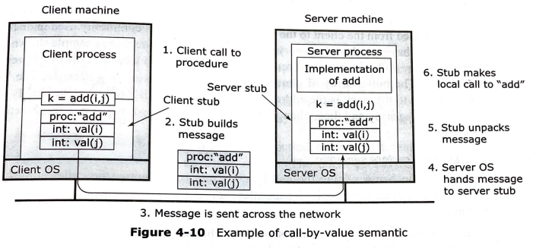
For example, a simple 'add‘ procedure, which is to be remotely executed.
Here the client stub puts the fol1owing values in the message:
Two parameters for execution.
Name or number of the procedure called in the message.

Slide 39
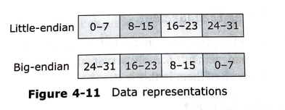
The RPC model works well if the client and the server machines are identical and the parameters and results are scalar types like integers, characters, or Boolean.
However, this may not hold true in a large distributed system.
For example:
IBM mainframes use EBCDIC character code, while IBM PCs use ASCII code.
Intel Pentium machines use 'little-endian' format, while Sun SPARC machines use 'big-endian' format

Slide 40
Call-by-value semantic is required because the client and the server exist in different address spaces and may be running on different types of machines.
It is ideal for close systems, where the client and the server share a single address space.
However, this semantics is unsuitable for transmitting large voluminous data like multidimensional array, trees, etc., where part of the data may not be required on the server side for executing the RPC.
Call by reference is a more suitable method for such cases.

Slide 41
2.2 - Call by Reference semantics
A pointer is meaningful only in the address space of the process where it is used.
RPC mechanisms allow parameter passing by reference, where pointers to the parameters are passed from the client to the server.
This mechanism is used in distributed systems having a shared memory architecture.
Example of Call by Reference is passing the address of a buffer array as a parameter.
The caller process or the called process both can modify the values in this shared array.

Slide 42
2.3 - Call by Copy/ Restore semantics
This mechanism is based on the concept of using a temporary storage which is accessed by both the caller and the called process.
During an RPC call using the Call by Copy semantics, the caller process copies the variables into a stack for executing the RPC and later copies back the values after execution is completed.
During this time, the called process can modify the values of these variables in the stack.

Slide 43
3. RPC Communication
In RPC, the caller and the called processes need to communicate with each other since they both are located on different machines.
We consider the following 3 important aspects of RPC Communication:
RPC call semantics
RPC communication Protocols.
Client-Server binding in RPC

Slide 44
3.1. RPC Call Semantics
Since the caller and the called process are located on different machines, both of them may fail independently and restart later.
It is also possible that the communication link may fail, leading to disconnection between the caller and the called process.
This may cause disturbance in the execution of the RPC and may even cause the caller or the called process to crash.
Hence, it is necessary for the RPC runtime systems to have an Integral failure handling mechanism.
The RPC Call Semantics defines how often a remote procedure would be executed under faulty conditions.

Slide 45
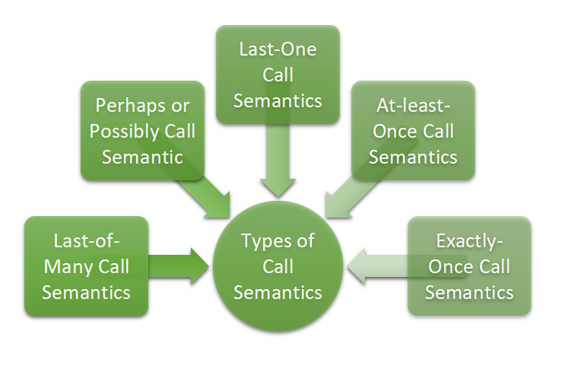
Types of RPC Call Semantics

Slide 46
3.1.1. Possibly or may-be call semantics
This is one of the weakest semantics.
The caller waits for a predetermined timeout period and continues with its execution.
There is no guarantee of receipt of the call message or procedure execution by the caller.
This semantic is ideal for applications where a response is not important for the caller, or in LAN’s with guaranteed successful message transmission.

Slide 47
3.1.2. Last-one call semantics
This semantic retransmits the call message, based on a predetermined timeout, until the caller receives the response.
The entire set of actions like caller calling the RPC, called process executing the procedure, and the caller receiving the results, are repeated until the caller receives the result.
The caller uses the results of the latest executed call, even though the earlier calls may have survived the crash.
This semantic is difficult to achieve in case of orphan calls.
Orphan calls are calls whose caller has expired due to a node crash. No parent is waiting for such calls, resulting in unwanted computation. These calls waste CPU cycles, lock files, and may tie up resources. If the client reboots, the computation repeats, leading to rework.

Slide 48
To achieve last-one call semantics, the various techniques used are as follows:
Extermination:
The client maintains a log on the disk, before it sends a call. On reboot, the log is checked and the orphan process is killed.
A 'Write to the disk' operation is an overhead in terms of cost and resources.
In situations where creation of grand orphans may take place due to an RPC themselves calling another RPC, extra write operations in the log are required.
This technique is expensive because of the cost of writing every record to the disk.
Reincarnation:
Time is divided into sequential numbered units called epochs.
A new epoch is started on reboot and broadcasted to all machines.
The remote computations are located and killed.
Some orphans may survive in partitioned networks. If the replies contain obsolete epoch numbers, we can detect the orphan calls.

Slide 49
Gentle Reincarnation:
On receiving the broadcast, each machine checks for remote computation to locate the owner.
If the owner is not found, then the computation is killed.
Expiration:
Each RPC is given a standard quantum of time to do the task.
The quantum is extended on request, if the task is incomplete.
When the server reboots after time T or crashes, the orphans are gone.

Slide 50
3.1.3. Last-of-many call semantics
Each RPC call is provided a unique Call-ID
Neglects orphan calls by using a call ID to uniquely identify each call.
New call IDs are associated with repeated calls.
The client checks the message ID and accepts the response, if the call ID matches the recently repeated call, else it ignores the message

Slide 51
3.1.4. At-least-once call semantics
As compared to last-of-many call semantics, the call is executed one or more times, but does not specify which results the caller gets.
Message timeout based on retransmission is used to implement this semantic without bothering about orphan calls.
In case of nested calls having orphan calls, the caller accepts the result of the first response message, but ignores others.

Slide 52
3.1.5. Exactly-once call semantics
Irrespective of how many times the caller retransmits, the procedure executes only once.
Hence, this is the strongest and most desirable call semantic.
It is a cheap semantic and is not advised for idempotent operations.
Idempotent operations are the operations where, if a procedure is executed more than once with the same parameters, the same results and side effects are produced.
Hence, the idempotent interfaces need to be designed by the application programmer

Slide 53
3.2. RPC Communication Protocols
On the basis of RPC, different systems have different IPC requirements.
Following are the various types of communication protocols used to cater to these differing needs of every system.
Request Protocol (R-Protocol)
Request/Reply Protocol (RR-Protocol)
Request/Reply/Acknowledge Protocol (RRA-Protocol)

Slide 54
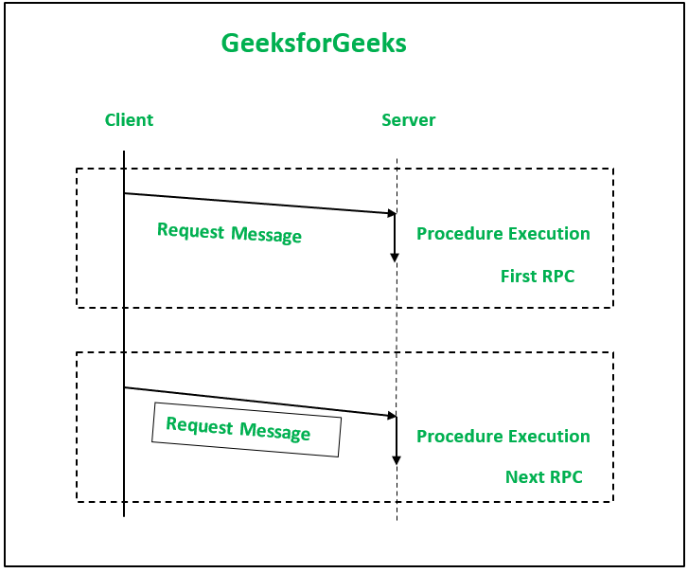
3.2.1. Request Protocol (R-Protocol)
Used in applications where the server procedure has nothing to return as a result of the procedure execution.
Client procedure requires no confirmation that the procedure has been completed.
Helps in improving Client-Server performance.
Client is not blocked waiting for result.
Server need not send a reply.
An RPC using this protocol is termed asynchronous RPC
The RPC runtime is not responsible for retrying the request, in case of communication failure.

Slide 55
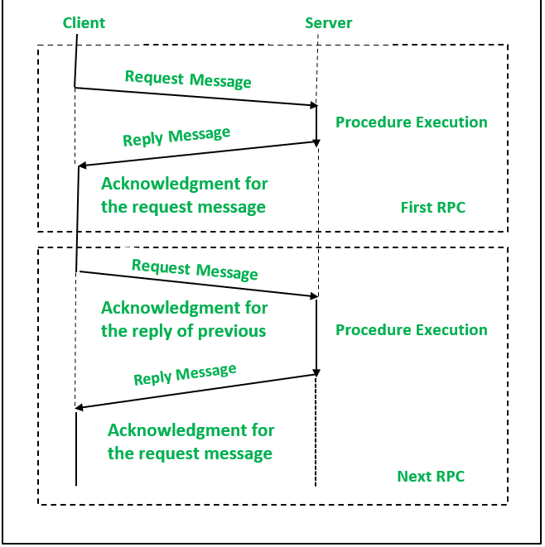
3.2.2. Request/Reply Protocol (RR)
This protocol is used for RPC whose arguments and results fit into a single packet buffer and where the call duration and the time between the call is short.
This protocol avoids explicit transmission of messages.
The server's reply message acts as acknowledgement of the client's request message
The subsequent call from the client is considered an acknowledgement of the server's reply message of the previous call made by the client.

Slide 56
The protocol uses timeouts and retries for handling failures, but it requires that the cache maintain the replies.
Retransmission of lost request message is done when there is no response.
If the servers interact with a large number of clients, the cache discards the data after a specific time.
This method is not reliable, because the messages that are not successfully delivered to the client are lost.
The RRA protocol is used to overcome this issue.

Slide 57
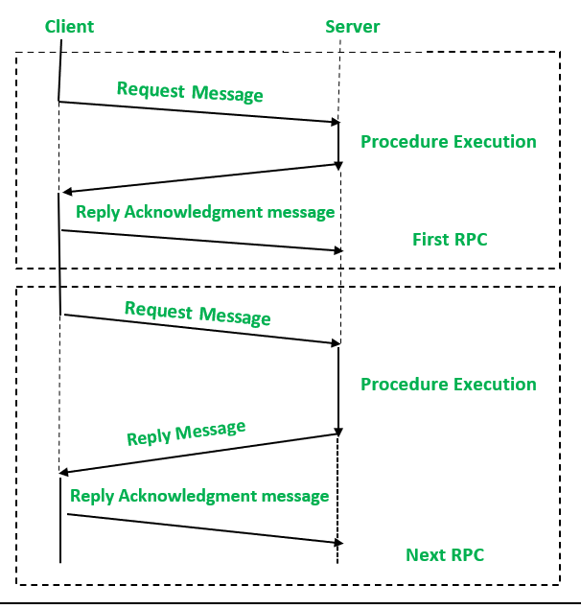
3.2.2. Request/Reply/Acknowledge Protocol (RRA)
This protocol requires that the client should acknowledge the receipt of the reply messages.
Subsequently, the server deletes those messages from the cache.
The RRA protocol involves three messages per call i.e Request, Reply & Reply Acknowledge
Unique IDs are assigned to every request message.
Reply messages are matched with the corresponding acknowledgement message.
The client acknowledges the reply message only if it receives the replies to all earlier requests.

Slide 58
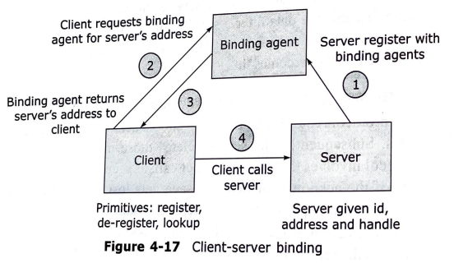
3.3. Client-Server binding in RPC
Client should know the location of the server before it could make a RPC request.
Client-Server binding is the process by which client gets associated to the server so that RPC call may take place.
In this process, Server exports it operations and registers with the binding agent.
Client imports these operations by requesting the RPC runtime system to locate the server for RPC execution.

Slide 59
The Client-Server binding process deals with the following steps:
Server Naming:
The client names a server with which it wants to communicate, by specifying its interface name. The type part of the interface name specifies the interface itself and its version number. The latter is used to distinguish between old and new versions of the interface.
Server Locating:
Interface name of the server is a unique ID. The server should be located before the client makes a request for RPC. A common method for server location is broadcasting where the client sends a message to all nodes to locate the server. The node having the specified server sends back a response message. If the server is replicated on many nodes, the response message is also received from multiple servers, but only the 1st response is considered.

Slide 60
Binding Agent:
It is a name server which binds the client to the server by giving the server location to the client.
This information is stored in the binding table which maintains the system-interface name mapping to the server location.
All servers register with the binding agent during the initialization process by giving an ID and a handle.
The server de-registers from the binding agent, if it does not want to offer its services.
The binding agent's location is broadcast to all the clients when it is relocated.
The primitives used to communicate with the binding agent are:
'Register' used by the server to register with the binding agent
'Deregister' used by the server to deregister with the binding agent
'Lookup' used by the client to locate the server

Slide 61
Advantages:
One of the advantages of the binding agent method is multiple server support, which provides fault tolerance as any server can offer its services in case of a failure.
The other advantages of this method are load balancing and security.
The server holds the privilege of serving authorized users, and refusing service to other users.
Drawbacks:
One of the drawbacks is the large overhead involved in binding a client to the server for short-lived processes.
For large networks, the binding functions are distributed among multiple agents by information replication. However, this involves extra overhead to maintain consistency.

Slide 62
Types of bindings:
Clients can be bound to a server in a variety of ways, such as fixed binding and dynamic binding.
In fixed binding, the client knows the network address of the server and hence the client can bind directly with the server and carry out RPC execution.
Fixed binding method fails if the server is moved or replicated.
The other method is dynamic binding, which can be carried out in any of the following three ways:
At Compile Time
At Link Time
At Call Time.

Slide 63
1. Binding At Compile Time
The client and the server modules are programmed as if they are to be linked together.
The programmer adds the server network address into the client code at compile time.
The client then finds it by looking up the server name in a file.
If the server moves or is replicated, it cannot be located.
Programs have to be found and recompiled if the server location is changed or the server is replicated.
This method is ideal for clients and servers having static configuration.

Slide 64
2. Binding At Link Time
The server exports its services by registering itself with the binding agent during the initialization process.
Before making a call, the client makes an import request to the binding agent.
The binding agent binds the client and the server and returns the server handle to the client, which makes the call to the server.
For the next set of calls to the same server, the server's handle is cached to avoid contacting the binding agent again.
This method works well for applications where the client needs to call the server several times once it is bound.

Slide 65
3. Binding At Call Time
Client is bound to the server when it calls the server for the first time during execution.
The client passes the server's interface name and RPC arguments to the binding agent.
The binding agent locates the target server and sends an RPC call message with arguments to it.
The server completes the RPC execution and sends the result back to the binding agent.
Binding agent then returns the result and the target server's handle to the client.
During subsequent calls, the client calls the server directly.

Slide 66
4. Server Management
In RPC-based applications, there are two important issues which need to be considered for server management, namely:
Server implementation
Server creation semantics.

Slide 67
1. Server implementation
We classify the servers as stateless and stateful, based on how they are implemented.
A stateless server, as the name suggests, does not maintain the state information of RPC execution in the system.
Hence, they include parameters for a successful operation in every request made by the client.
On the other hand in a stateful server if the client makes multiple calls, the state information for all the calls is maintained by the server process.
Subsequent calls execute with the help of earlier state information.

Slide 68
A stateful server is easy to restart in case of failure.
This type of server relieves the client from maintaining the state information.
In the event of a failure, if the stateful server crashes and restarts, all the earlier information is lost.
Being unaware of this problem, the client will produce inconsistent results.
Similarly if the client crashes, the server may keep on holding unwanted state information.
However, Stateless servers have a distinct advantage in case of failures, because the client keeps retrying until the server responds. Hence, stateless servers make crash recovery easy.

Slide 69
2. Server creation semantics
During an RPC call the client and the server processes execute independently, i.e. they run on separate machines which have separate address spaces and lifetimes.
Therefore, the middleware creates and installs the server process earlier or creates it on demand.
Depending upon the time duration for which a server is active, servers are classified as follows:
Instance-per-call
After RPC execution, middleware destroys the Instance-per-call server.
They are stateless servers and client process or the OS maintains the state info.
This approach is expensive and not suitable if the same server needs to be invoked repeatedly.

Slide 70
Instance-per-session
There is a server manager for every service and every manager registers with the binding agent.
To execute an RPC call, the Client contacts the binding agent who in turn provides the client with the address of the Server manager.
The client and server now interact directly.
When client informs the server about the completion of the RPC call, the server instance is destroyed.
Persistent Servers
Server exists indefinitely and is sharable among clients.
Created and installed before client uses it.
Client contacts the binding agent for RPC execution who in turn provides the client with the server address.

Slide 71
Remote Method Invocation (RMI)

Slide 72
Object-oriented models are efficient for developing non-distributed applications.
The object interface hides the internal structure from the outside world. Therefore, it is easy to replace objects by maintaining the same interface.
The principle of RPC can be applied to handle objects, i.e. invocation of remote objects.
With this concept, objects in different procedures can communicate with each other through RMI or Remote Object Invocation.
It is an extension of local method invocation which allows objects in one process to invoke methods of an object in another process on the same machine.

Slide 73
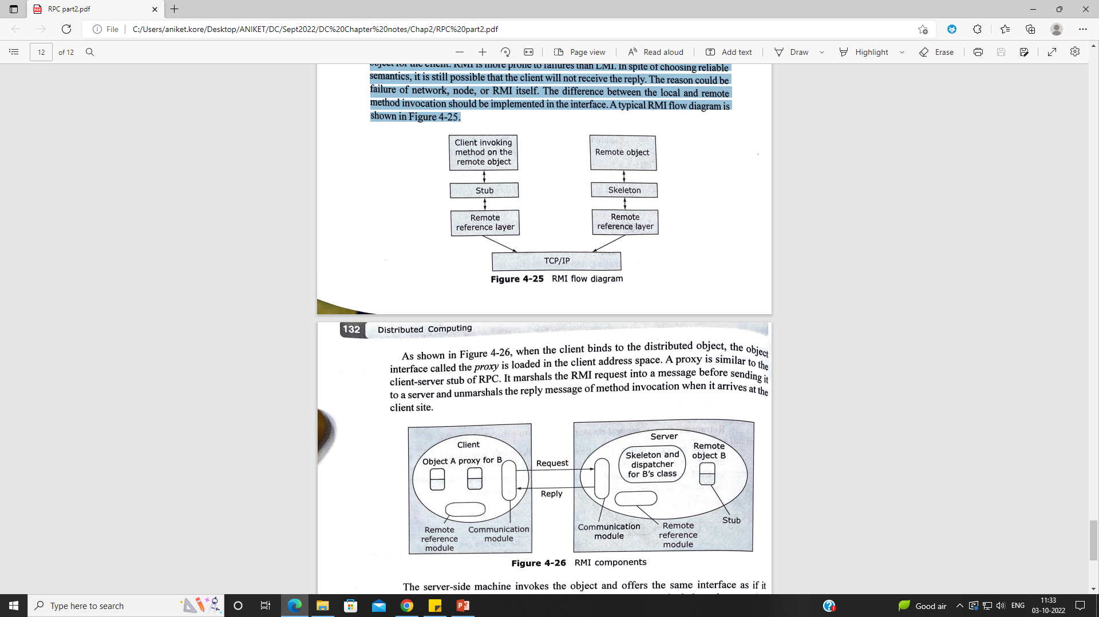
RMI components
RMI is more prone to failures than LMI.
In spite of choosing reliable semantics, it is still possible that the client may not receive the reply due to reasons such as failure of network, node, or RMI itself.
A typical RMI flow diagram is shown as follows.

Slide 74
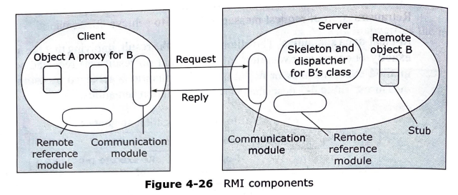
When the client binds to a distributed object, the object interface called PROXY is loaded into the clients address space.
Proxy is similar to the Client-Server Stub of RPC.
It marshals the RMI request into a message before sending it to a server and unmarshals the reply of the method invocation when it reaches back to the client.

Slide 75
Design Issues in RMI
We consider two main points for RMI design:
Local invocations execute only once, but the same does not hold true for RMI.
However, RMI invocation semantics provides us different ways to ensure that RMI executes exactly once.
Level of transparency: Just like RPC communication protocols, the following schemes decide guaranteed delivery of RMI messages:
Should the client retransmit request messages, until it receives the reply or assume server failure?
During retransmission, should the server filter duplicate requests?
Should the server cache the results and use them during retransmissions?

Slide 76
1.Maybe Semantics:
The remote method may be executed once or not at all.
Maybe semantics arises when no fault tolerance measures are applied.
Useful only for applications in which failed invocations are acceptable.
This model can suffer from the following types of failure:
Omission failures if the invocation or result message is lost
Crash failures when the server containing the remote object fails.

Slide 77
2. At-least-Once Semantics:
The invoker receives either
a result, in which case the invoker knows that the method was executed at least once.
an exception informing it that no result was received.
Can be achieved by the retransmission of request messages, masking the omission failures of the invocation or result message.
This model can suffer from the following types of failure:
Crash failures when the server containing the remote object fails
Arbitrary failures, in cases when the invocation message is retransmitted, the remote object may receive it and execute the method more then once, possibly causing wrong values to be stored or returned.

Slide 78
3. At-Most-Once Semantics:
The invoker receives either -
a result, in which case the invoker knows that the method was executed exactly once.
an exception informing it that no result was received, in which case the method will have been executed either once or not at all.
Can be achieved by using a combination of fault tolerance measures such as retransmission, duplicate filtering (i.e. filtering out duplicate msgs at the server).
The use of retries masks any omission failures of the invocation or result messages.
Arbitrary failures are prevented by ensuring that for each RMI a method is never executed more than once.

Slide 79
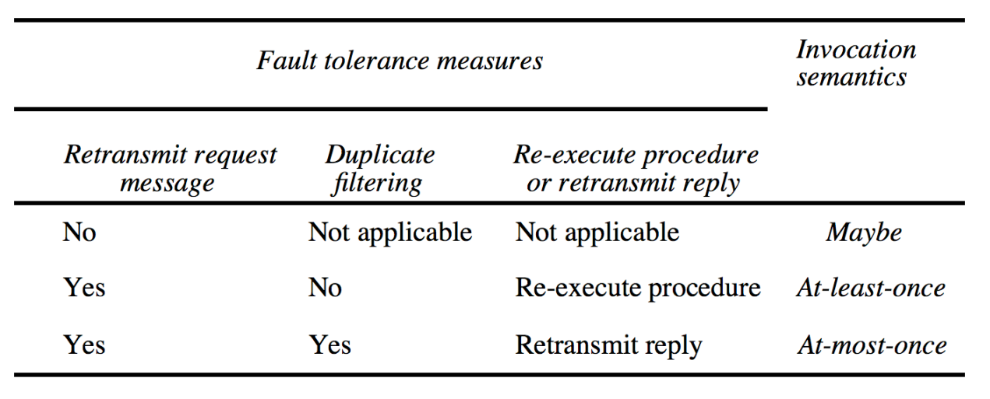
RMI Invocation Semantics Summary

Slide 80
RMI Execution
The various components and the process of RMI execution, as shown in the adjoining figure include the following Components:
Communication module
Remote reference module
RMI software
Server and the client programs
The binder.

Slide 81
1. Communication module:
The client and the server processes form a part of the communication module which use RR protocol.
The format of the request-and-reply message is very similar to the RPC message.
2. Remote reference module:
It is responsible for translating between local and remote object references and creating remote object references.
It uses a remote object table which maps local to remote object references.
This module is called by the components of RMI software for marshaling and unmarshaling remote object references.
When a request message arrives, the table is used to locate the object to be invoked.

Slide 82
3. RMI Software:
It is the middleware layer and consists of the following:
A) Proxy:
Makes RMI transparent to the client and forwards the msg to the remote object.
It Marshals the arguments and Un-marshals the results. It also sends and receives msgs from the client.
There is 1 proxy for each remote object for which it holds remote reference.
B) Dispatcher:
Server consists of 1 dispatcher and skeleton for each class which represents remote object.
This unit receives the request msg from the communication module, selects the appropriate method from the skeleton, and passes the request msg.

Slide 83
C) Skeleton:
It implements the method in the remote interface.
Un-marshals the arguments in the request msg and invokes the corresponding method in the remote object.
After execution, it marshals the result in the reply msg to send to proxy’s method.
4. Server and Client Program:
Server program contains classes for dispatcher, skeleton and remote objects that it supports.
Client program contains classes of processes for the entire remote object, which it will invoke.
Client looks up the remote object reference using the Binder.

Slide 84
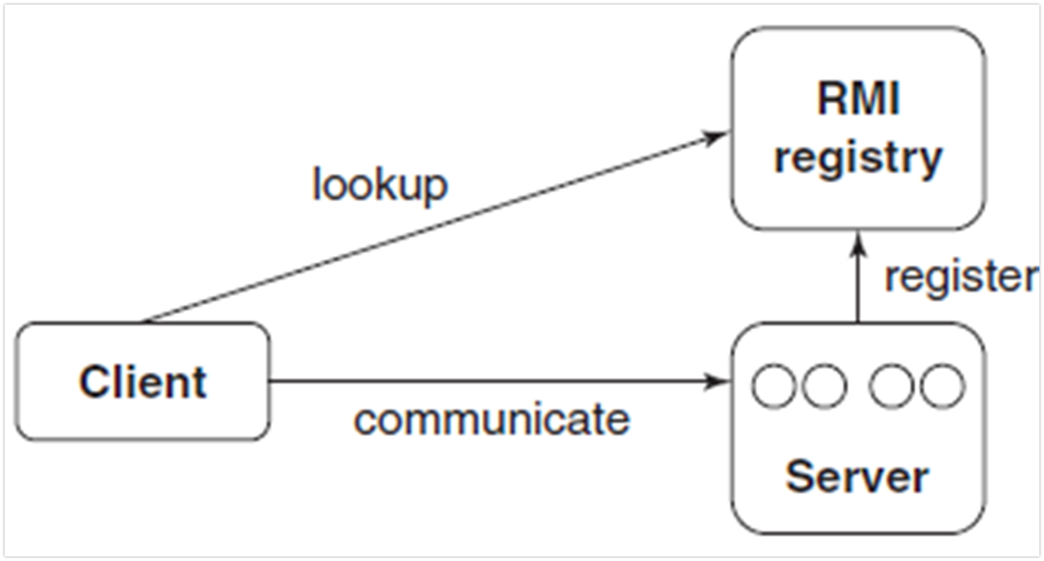
5. Binder:
It is a service in distributed systems that maintains a table of textual names to be remote object referenced.
Servers use it to look up the remote object references.
Adjoining figure shows how objects can be accessed remotely.
RMI mechanism

Slide 85
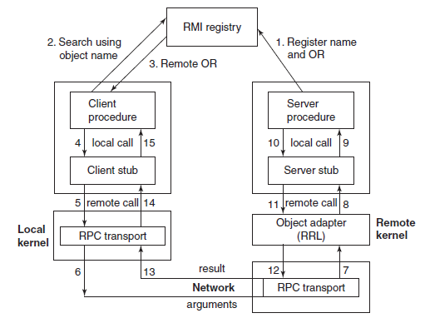

Slide 86
Message-Oriented Communication
Types of Communication:
Persistent versus Transient
Synchronous versus Asynchronous

Slide 87
1. Persistent versus Transient Communication
Persistent: messages are held by the middleware comm. service until they can be delivered (e.g., email)
Sender can terminate after executing send
Receiver will get message next time it runs
Transient: messages exist only while the sender and receiver are running
Communication errors or inactive receiver cause the message to be discarded
Transport-level communication is transient
Message is stored only so long as both sender and receiver are running.
The system will discard the message if it can not be delivered to receiver.

Slide 88
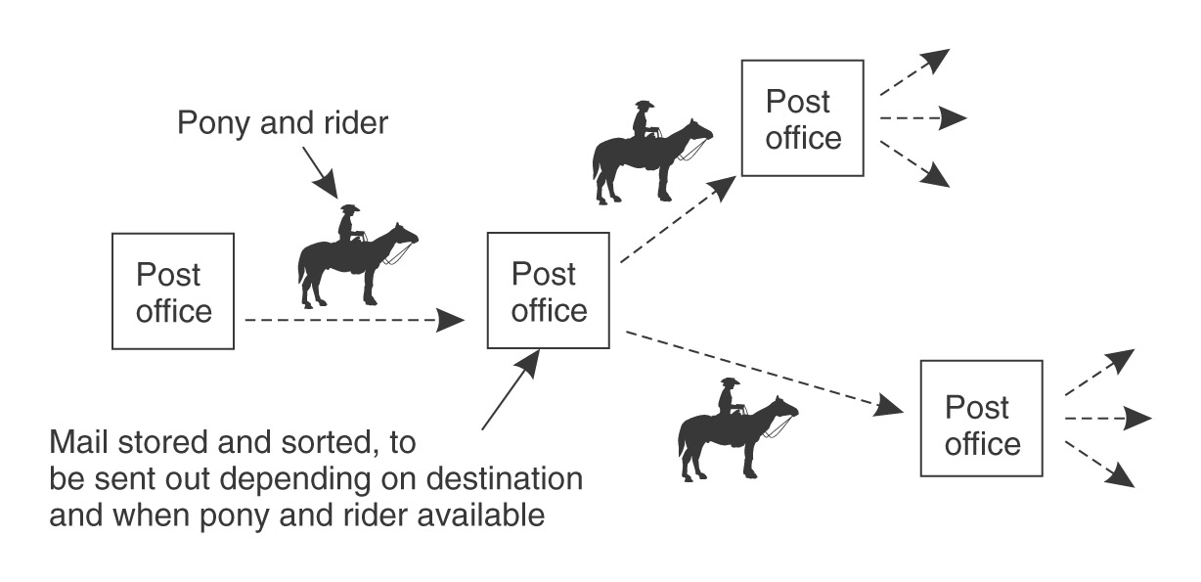
Persistent Communication

Slide 89
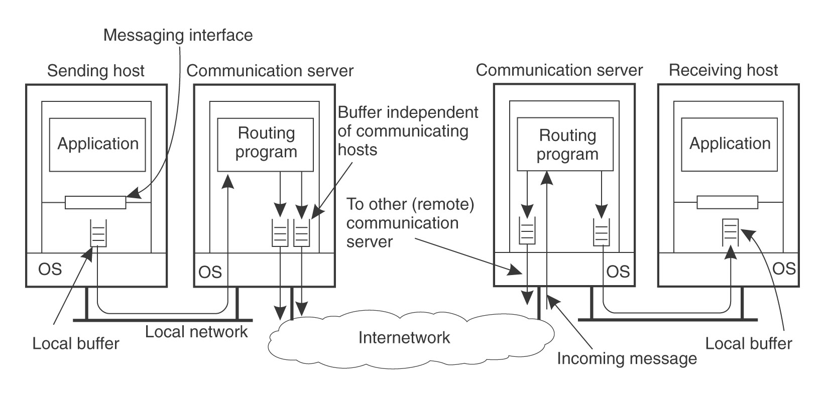
Persistence and Synchronicity in Communication

Slide 90
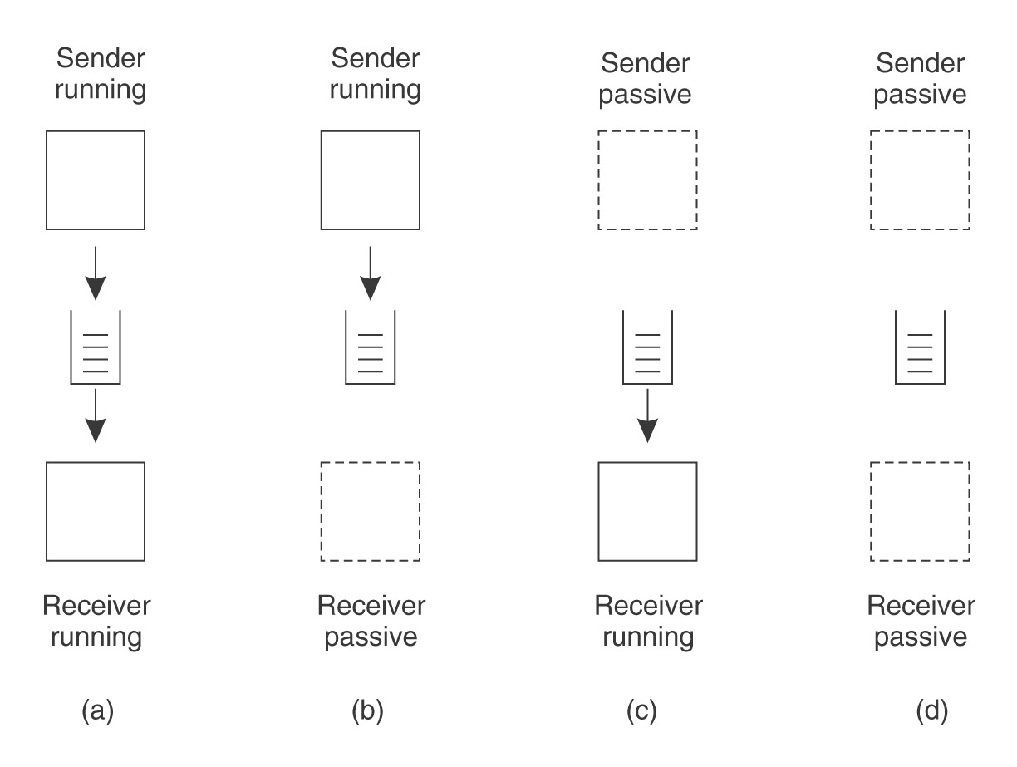
Message-Oriented Middleware (MOM) - Persistent
Processes communicate through message queues
Queues are maintained by the message-queuing system
Sender appends to queue, receiver removes from queue
Neither the sender nor receiver needs to be on-line when the message is transmitted

Slide 91
Asynchronous:
Asynchronous communication means that the sender is doing non-blocking sending.
It continues immediately after submitting the message.
Synchronous:
Synchronous communication blocks the process until the message is received or the sender gets a response from the server

Slide 92
Combinations
Persistent Asynchronous
Persistent Synchronous
Transient Asynchronous
Transient Synchronous
Receipt-based
Delivery-based
Response-based

Slide 93
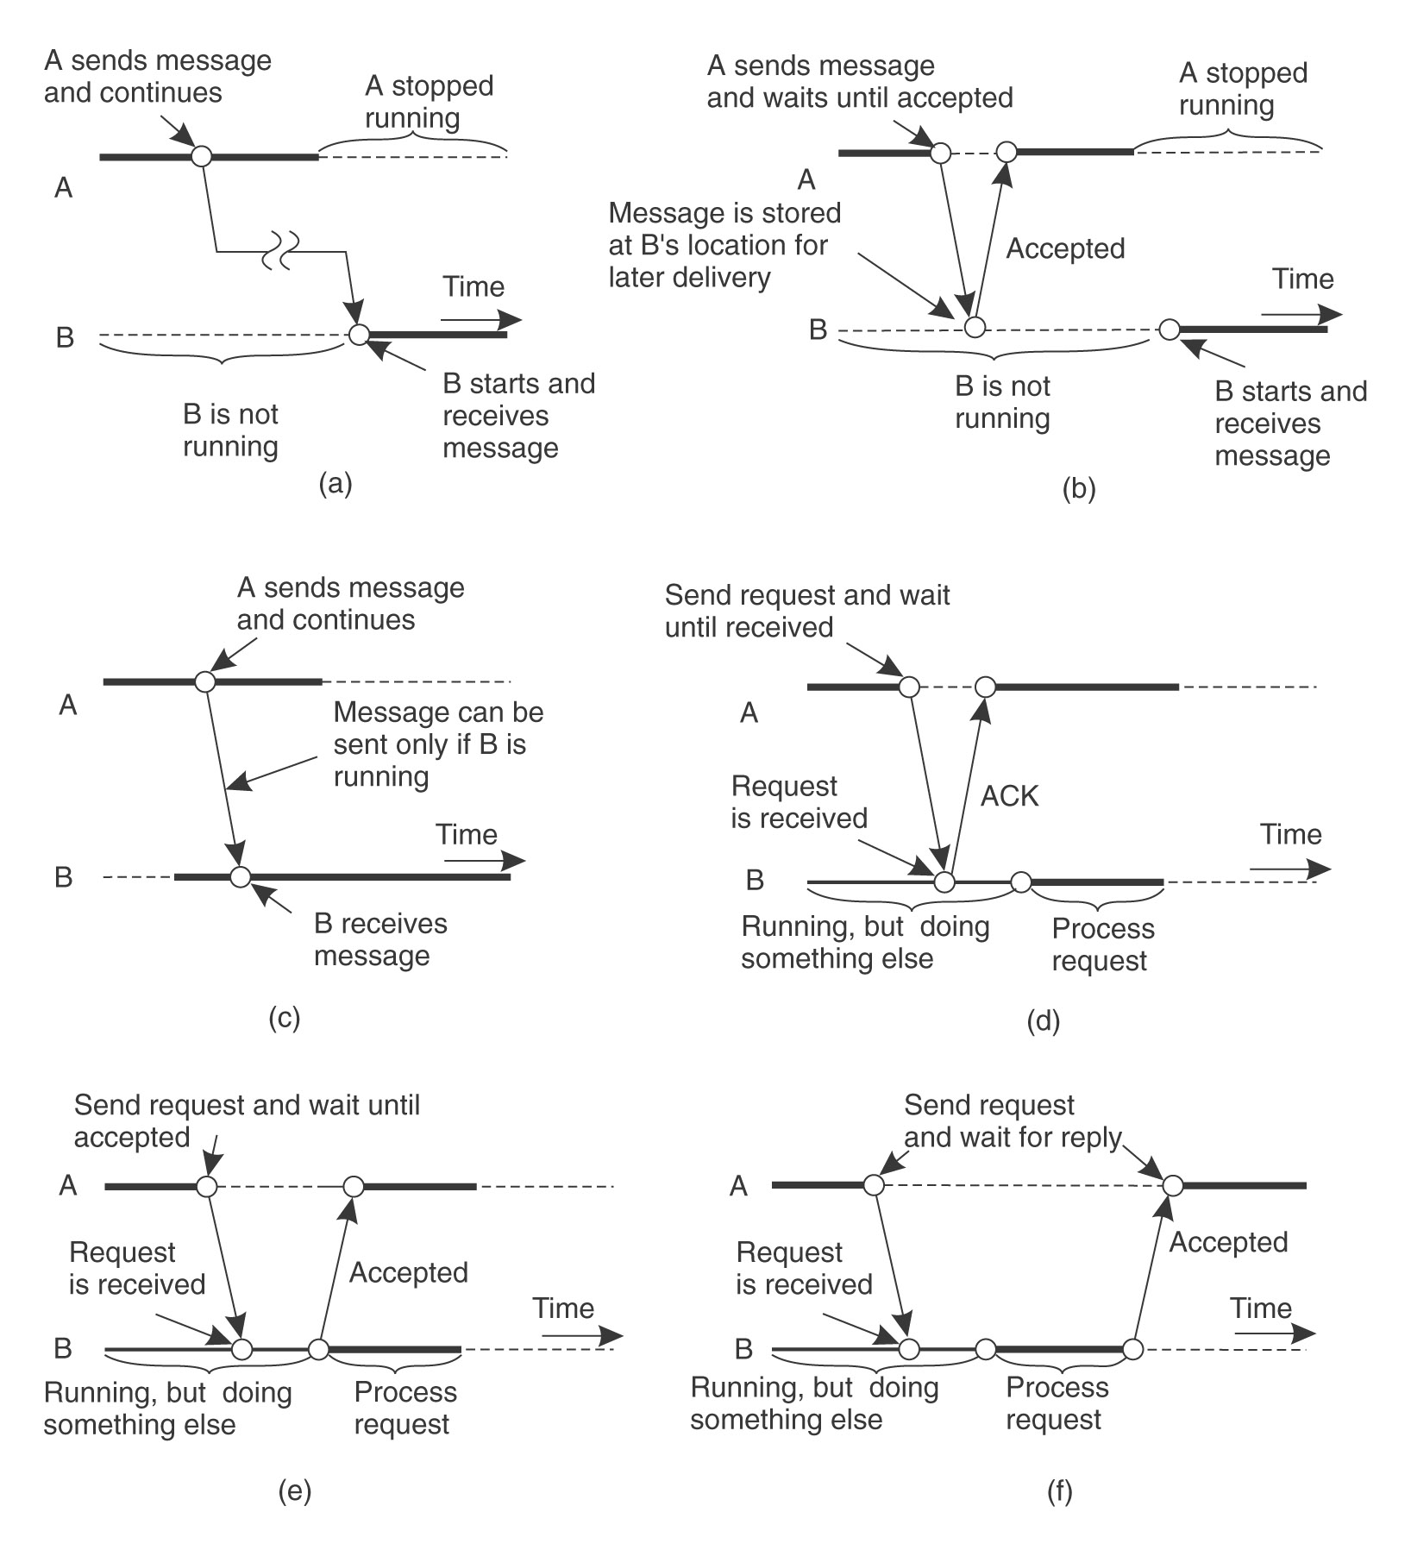

Slide 94
Group communication
One to many:
Many to One
Many to Many

